Slide 1
Write the Rights!
SS.7.C.2.4 Evaluate rights contained in the Bill of Rights and other amendments to the Constitution.
Evaluating rights in the U.S. Constitution

Slide 2
As You Enter the Class…
Turn on your camera and mute your mic.
Type your name into the chat.
Go to the Bell Ringer tab and start working on the question for the day.

Slide 3
BELL RINGER
What are some of the rights that you have? See if you can come up with 3 or 4.

Slide 4
REVIEW: What does it mean to be a citizen?
Citizen: A legally recognized member of a country.

Slide 5

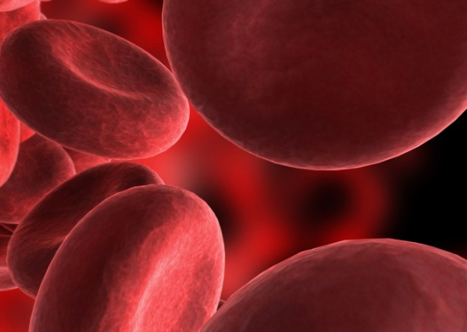
Natural Born Citizenship is based on two “laws”:
“Law of Blood”
Children born to a parent or parents who are United States citizens.
“Law of Soil”
Children born in the United States or Territories/Possessions
S
B

Slide 6
Naturalization
How someone can become a citizen of the United States by:
Living in the US for at least 5 years
Demonstrating good character
Passing a citizenship test

Slide 7
Defining Immigrants, Residents, and Aliens
Immigrant
Alien
A person who comes to live permanently in a foreign country.
A resident is someone who has been legally allowed to live in the United States, but is not a citizen
Any person not a citizen or national of the United States.
Resident

Slide 8
QUIZ: Citizenship
Work on our citizenship quiz found on the Assignments tab.

Slide 9
Role of the Constitution
Outline the structure and function of government
Protect the rights of the people

Slide 10
The Bill of Rights
Rights: guarantees or protections
Bill of Rights: The first 10 amendments to the US Constitution
Amendments are changes or additions to a document

Slide 11
HOW DID WE GET THE BILL OF RIGHTS?
Federalists vs. Anti-Federalists

Slide 12
Difference of Opinion
Federalists
Anti-Federalists
Were worried that the Constitution would bring tyranny
People should be protected from the power of government by having clearly outlined rights in a “Bill of Rights” in the Constitution
Wanted the Constitution to be approved
Believed the Constitution in its original form would protect the rights of the people

Slide 13
Let’s look at our Rights!
We will be looking at some of the rights in the U.S. Constitution. As we go through the PowerPoint, identify the rights in the scenarios on your handout and write down the right!

Slide 14
1st Amendment
Find the five rights in the First Amendment:
Congress shall make no law respecting an establishment of religion, or prohibiting the free exercise thereof; or abridging the freedom of speech, or of the press; or the right of the people peaceably to assemble, and to petition the Government for a redress of grievances.

Slide 15
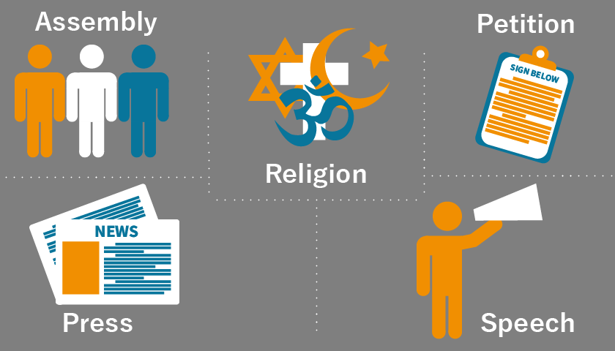
1st Amendment

Slide 16
Assignment
Go to the Assignments tab and find the assignment called “1st Amendment”

Slide 17
Lunch
We will be at lunch from 11:50am to 12:20pm
Please be back on our video call at 12:20pm.

